Slide 1
Believe. Validate. Support.
VOICES of Stephenson county
Serving survivors since 1982

Slide 2
Who we are
VOICES of Stephenson County is a dual service agency, providing service to survivors of domestic violence and sexual assault

Slide 3
VOICES Mission
The mission of VOICES of Stephenson County is to offer individuals and families victim-centered services and support in the treatment and prevention of domestic violence and sexual assault and abuse.

Slide 4
Voices philosophy
The philosophy of VOICES of Stephenson County is that there is no justification for domestic or sexual violence. It is never the victim’s fault. VOICES works to empower victims to make positive choices that will help to end the violence in their lives.

Slide 5
Diversity Statement
In order to effectively govern our organization and help those seeking our services, VOICES will recruit board and staff with a variety of skills, including, but not limited to, finance, human relations, legal, marketing, and operations. All persons must possess strong leadership abilities and a commitment for our mission. Recruitment is based solely on these qualities not pertaining to race, religion, gender, or age.

Slide 6
Voices history
VOICES began as a YWCA (Young Women Christian Association) in 1917 in Freeport, Illinois. In 1982, the YWCA established the VOICES program out of the organization’s desire to eliminate domestic violence in Stephenson County. In October 2005, the VOICES program incorporated as a separate not-for-profit organization under the name of VOICES DV. The VOICES Book Nook, a used bookstore located in the Lincoln Mall, was launched in 2010 to help support the agency’s operations and direct services. In July 2014, with the closing of Assault & Abuse Services of Stephenson County, VOICES DV began offering advocacy and therapy services to victims of sexual assault and abuse in Stephenson County as well as prevention education for students. Today the organization provides a wide variety of coordinated services to over 400 adults and children in Stephenson County.

Slide 7
Domestic Violence and Sexual assault epidemic
Nationally, domestic violence represents at least 15% of all violent crime, 20 people per minute are physically assaulted by an intimate partner which equates to 1 million people per year in the United States, and Stephenson County continues to report a higher rate of sexual abuse in children compared to surrounding counties.

Slide 8
Voices services
Crisis Intervention
Counseling
Case Management
Legal Advocacy
Medical Advocacy
Rapid Re-Housing Program
Prevention Education
Community Outreach
Emergency Shelter

Slide 9
Crisis intervention
Walk-in services
24/7 Hotline

Slide 10
counseling
Ages 3+
Domestic Violence and/or Sexual Assault Education
Processing
Coping Strategies

Slide 11
Case management
Service plans
  Housing
  Orders of protection
  Employment
  Child care

Slide 12
Legal advocacy
3 Types of orders
  Order of Protection
    EOP – Short Term
    OP – Long Term
  Civil No Contact Order
    Involves Sexual Assault
  Stalking No Contact Order

Slide 13
Medical advocacy
ER Response
  Domestic violence and sexual assault education
  Resources
  Support

Slide 14
Rapid re-housing program
Year Long Program
VOICES covers 100% of the rent for the first 8 months
Survivor is the tenant

Slide 15
Prevention education
40 Hour Sexual Assault Crisis Intervention Training
Sexual Harassment Training
Prevention Education in the Schools
Community Mobilization and Education

Slide 16
Emergency shelter
90 Day Stay
6 Bedroom Currently
  One Family per Room
  Shared Bathrooms
Pet Friendly
24/7 Staff

Slide 17
Community partners/Community Outreach
Freeport Police Department
  Department of Justice (DOJ) - Office on Violence Against Women’s (OVW) Grant
  Improving Criminal Justice Response (ICJR)
TASK Force
  Quarterly Meetings
Tyler Justice Center
  Child Advocacy Center
  MDT
Adult Protective Services/Senior Resource Center
Stephenson County Sheriff Dept.
FHN
Highland Community College
Stephenson County State’s Attorney Office

Slide 18
What can you do?
Believe, validate, support
Listen & provide emotional support
Respect their privacy
Know your resources
Help with safety planning
Spread awareness

Slide 19
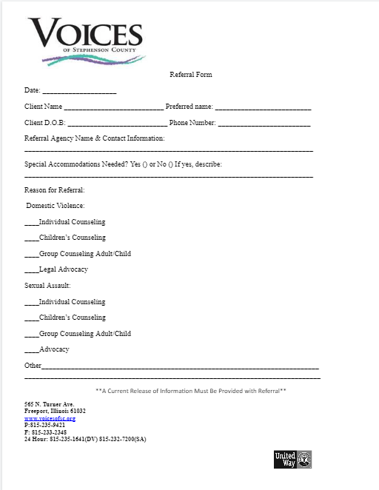
Referrals
Iris
  https://community.connectwithiris.org/users/sign_in
  https://connectwithiris.org/knowledgebase/making-referral
Referral form

Slide 20
Contact Info
Domestic Violence hotline
Sexual Assault hotline
(815) 235-1641
(815) 232-7200

